Slide 1
Vibrometer Experiment
Estimating Transfer Functions
Last update!

Slide 2
Changes from last week:
Took more measurements
Kept glass at same position, changed frequency of square wave instead
Put first microphone on top of speaker instead of in front of it
Looked at original measurements more
Added bandpass filter
Adjust based on frequency of square wave
Reduced segment size for smoother results
Measurement | Square Wave Frequency (Hz)
1 | 100
2 | 200
3 | 300
4 | 400

Slide 3
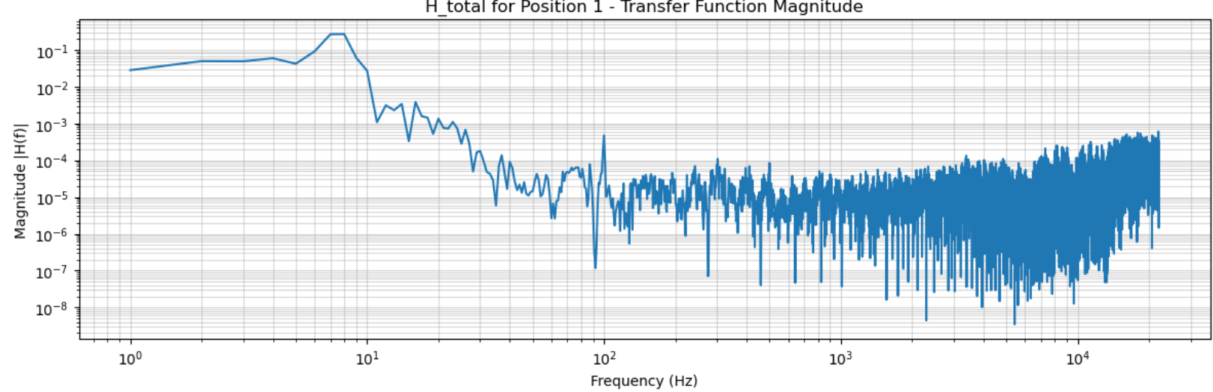
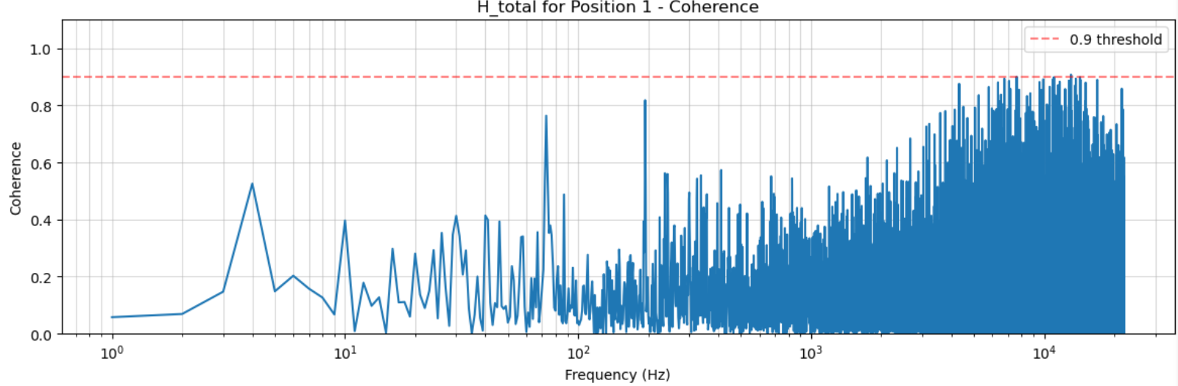
100 Hz Square Wave
Previous plots from last week:
Notes:
Reminder of the previous plots from last week

Slide 4
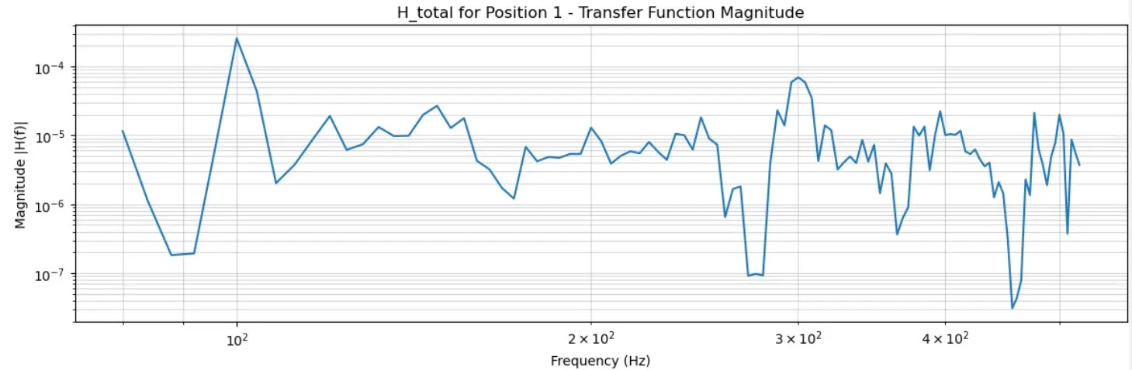
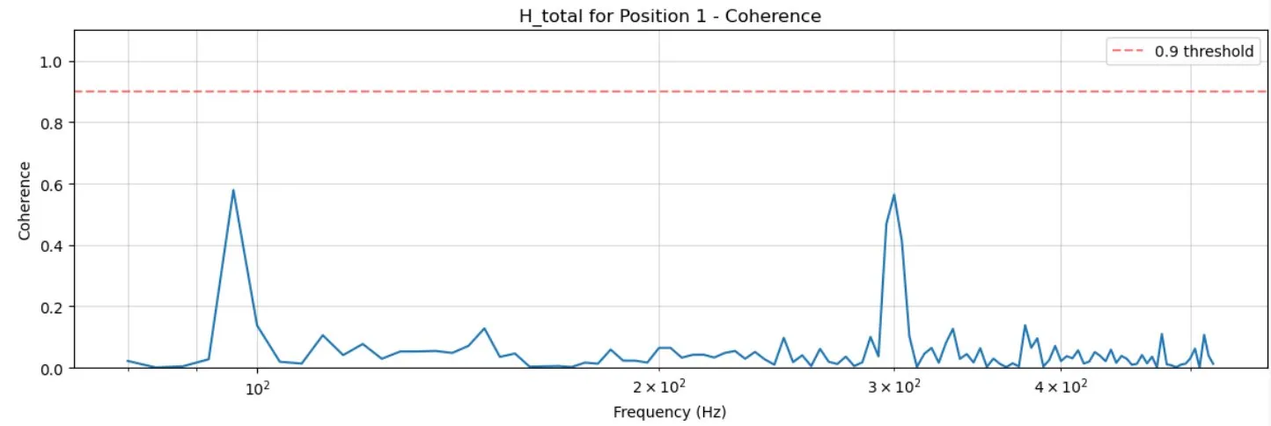
100 Hz Square Wave
Same plots after adding bandpass filter and reducing segment size
Clear peaks in coherence at ~100 Hz and ~300 Hz (fundamental & 3rd harmonic)
Notes:
Note about square waves: only odd harmonics will show up, even harmonics get cancelled out
Position 1: glass is 10 cm from the speaker

Slide 5
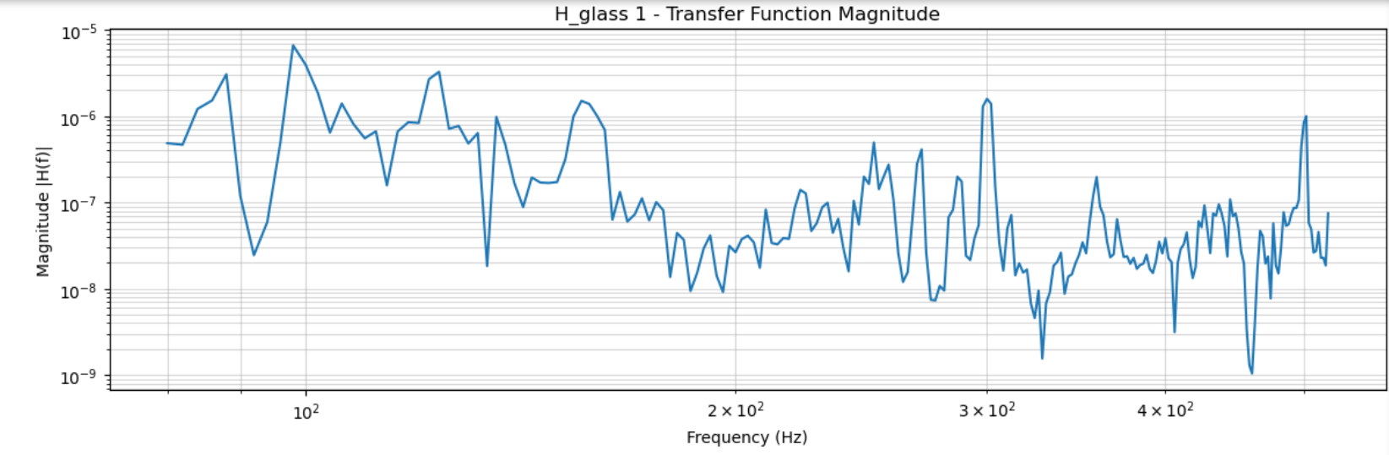
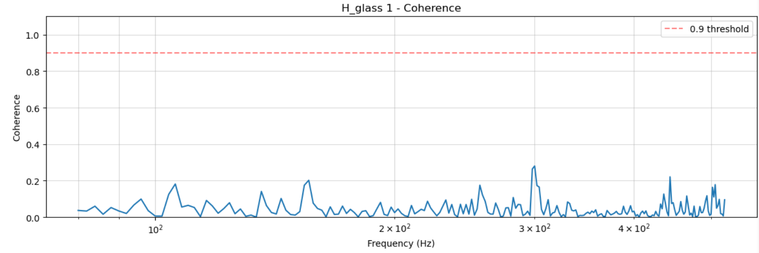
New Measurements (Changing Square Wave Frequency)
Coherence still low, similar problems aligning microphone recordings with vibrometer measurements in time
Notes:
Plots show 100 Hz square wave results, but results look similar for all square wave frequencies that I tried

Slide 6
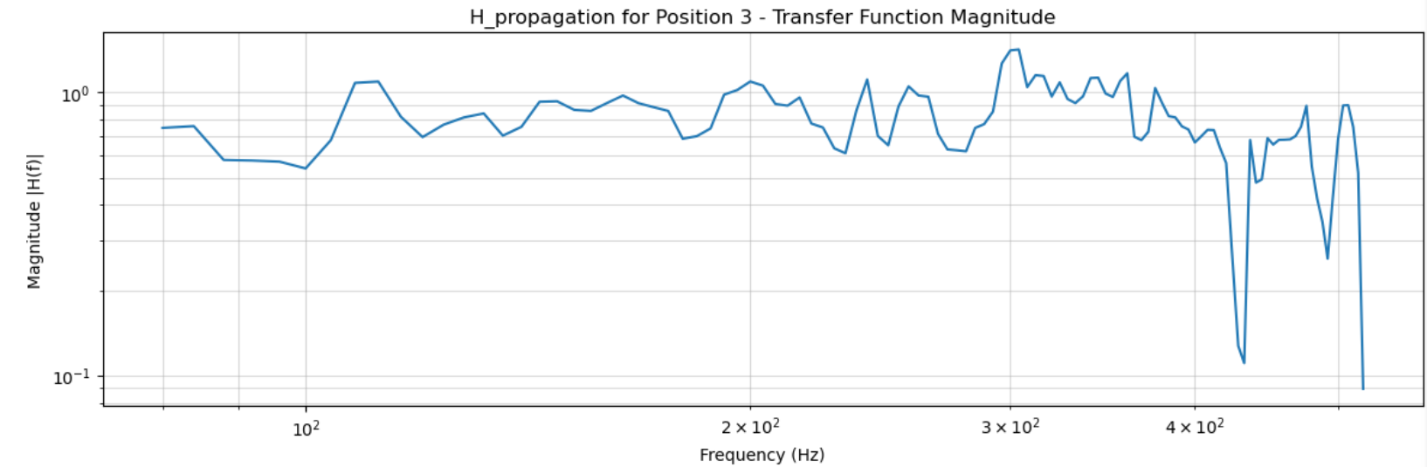
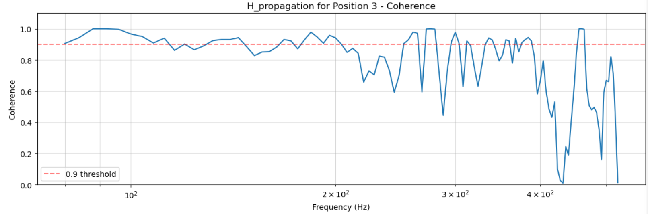
Testing Program Using Only Microphone Measurements
Used microphone measurements from different positions as input/output for transfer function estimate
Notes:
These results indicate that the code is working correctly, the experimental stuff may just need more adjusting/refining
H_propagation: both input and output are from microphone

Slide 7
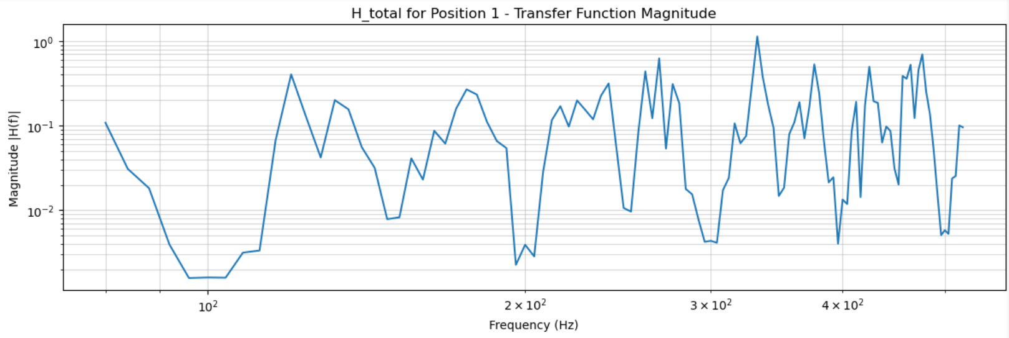
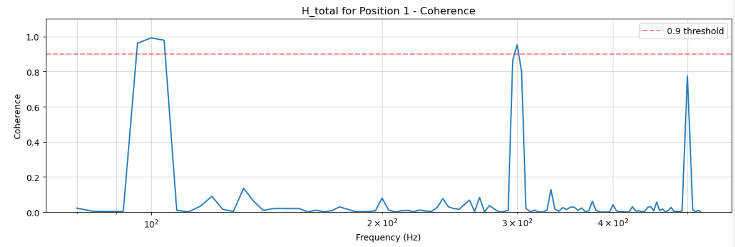
Testing Program Using Only Vibrometer Measurements
Used two vibrometer measurements (one without glass/directly on speaker, one with glass)
Shows coherence peaks at harmonic values again
Notes:
This is for the 100 Hz square wave
Got more success than with using one microphone recording and one vibrometer recording

